Slide 1
Secure Data Hiding In Images Using Steganography
CAPSTONE PROJECT
Presented By: Darshan Chotalia
Student Name : Darshan Chotalia
College Name & Department : Bharti Vidhyapeeth –
Information Technology

Slide 2
OUTLINE
Problem Statement
Technology used
Wow factor
End users
Result
Conclusion
Git-hub Link
Future scope

Slide 3
Problem Statement
What is the problem?
Data breaches and cyber threats are increasing.
Sensitive information needs secure transmission.
Conventional encryption methods can be detected and cracked.
How does this project solve it?
Steganography helps hide data inside images, making it undetectable.

Slide 4
Technology used
Programming Language: Python
Libraries & Tools:
OpenCV (for image processing)
NumPy (for data handling)
PILLOW (for image manipulation)
Cryptography (for additional security)
Platform: Windows 11
Concept Used:
Least Significant Bit (LSB) steganography

Slide 5
Wow factors
Undetectable Data Transmission: Hidden messages inside images appear unchanged.
Dual-layer Security: Encryption + Steganography ensures high security.
Minimal File Size Increase: No significant change in image size after data embedding.
User-Friendly: Can be integrated into messaging apps for secure communication.

Slide 6
End users
Government Agencies: Securely transmit confidential information.
Journalists & Whistleblowers: Share sensitive data without detection.
Corporations: Protect trade secrets and business communications.
General Users: Secure personal data like passwords, messages, and keys.

Slide 7
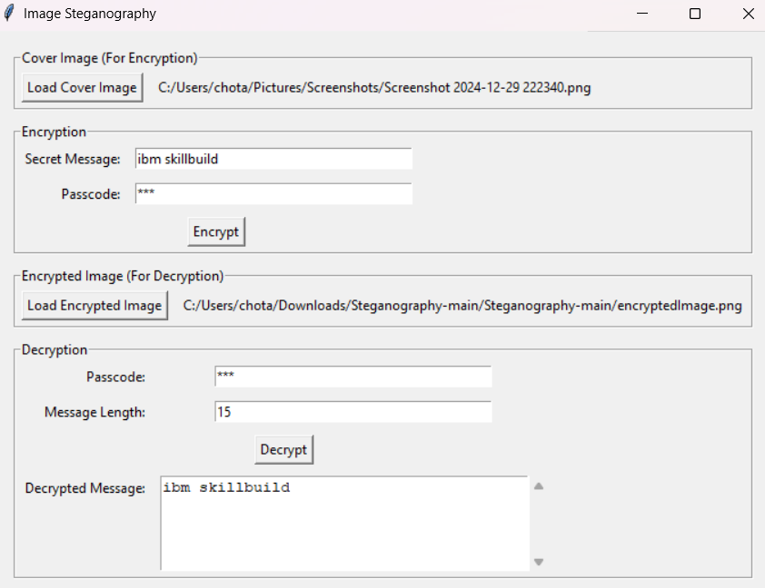
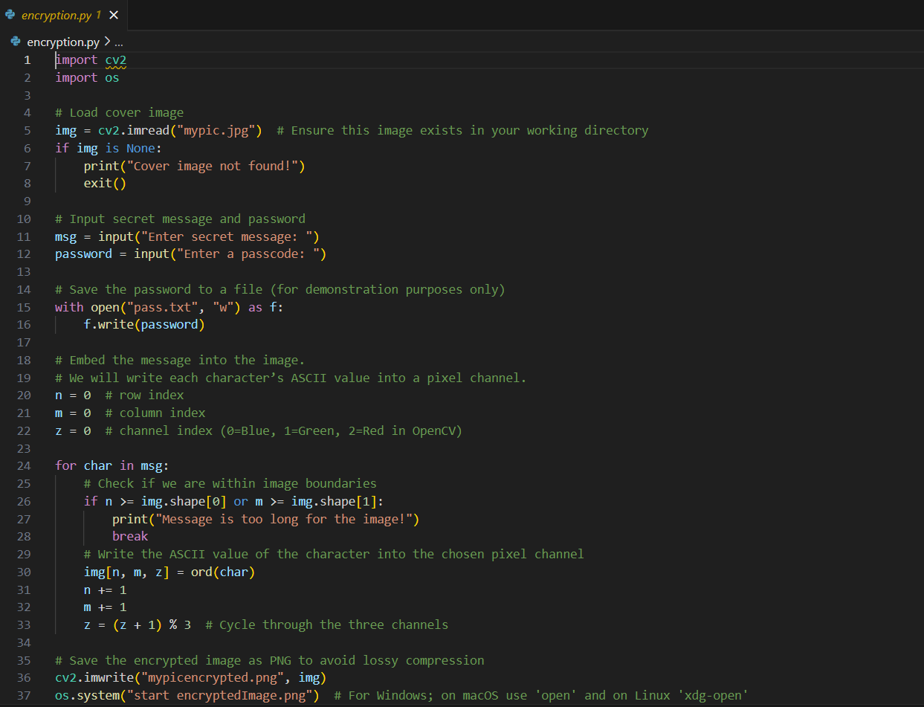
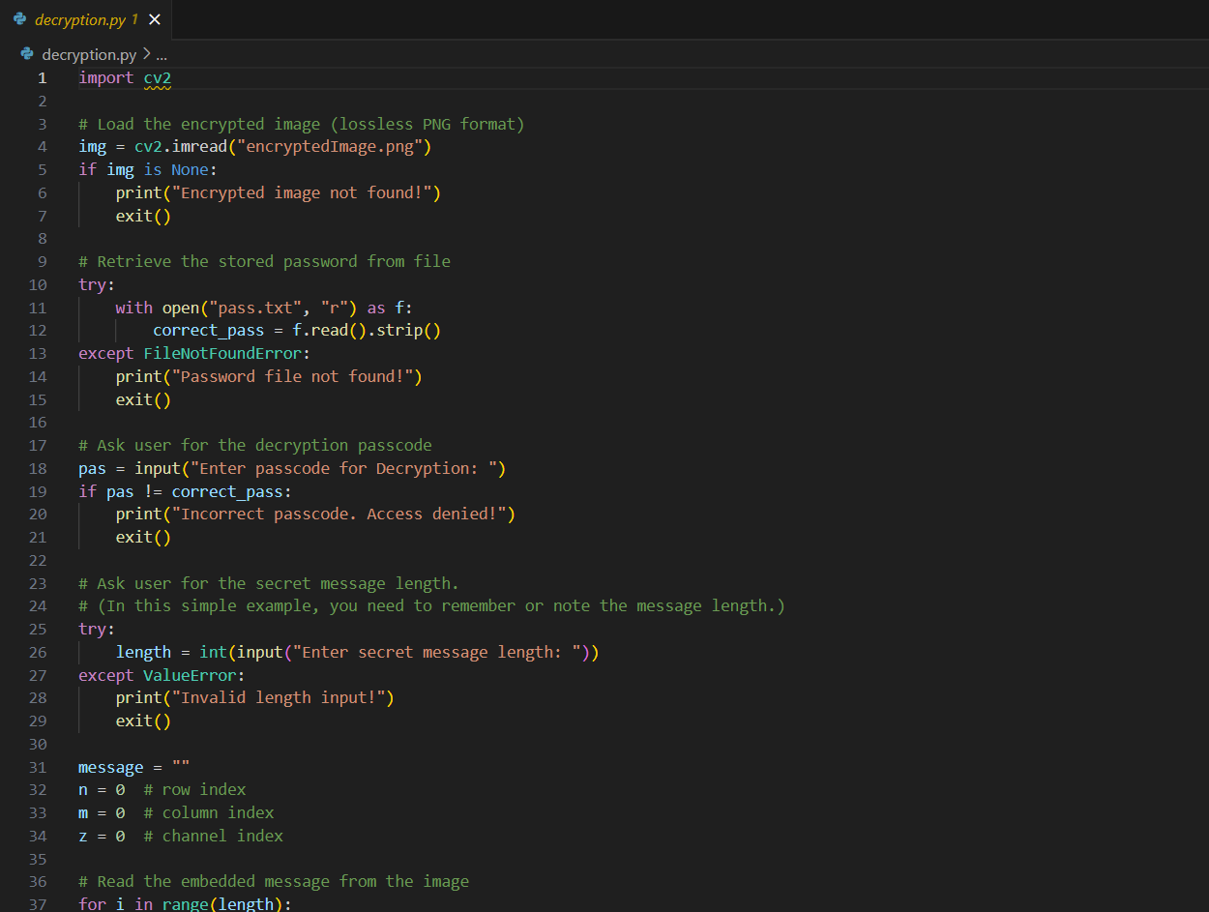


Results
GUI:
Encryption Code:
Decryption Code:
Input Image File:
Output Image File:

Slide 8
Conclusion
Achieved Goals:
Developed a working model for image-based data hiding.
Ensured data security using cryptographic methods.
Project Impact:
Enables secure communication.
Increases awareness of steganography in cybersecurity.

Slide 9
GitHub Link
Make sure that there should be readme file

Slide 10
Future scope(optional)
Improved Security: Use AI to detect steganographic attacks.
Higher Capacity: Explore better algorithms for embedding more data.
Cross-Platform Integration: Implement in secure messaging apps.
Steganalysis Prevention: Enhance robustness against detection methods.

Slide 11
THANK YOU

